Slide 1

Exam AI-100: Designing and Implementing an Azure AI Solution Crash Course
Tim Warner

Slide 2


Tim Warner
Based in Nashville, TN, US
MCT, MVP
Twitter: @TechTrainerTim
Badge: TechTrainerTim.com

Slide 3
Course Materials
timw.info/ai100

Slide 4
Session 1 of 2 Learning Goals
Introduction
Fundamental Terminology
Supporting AI in Azure Resource Manager
Azure Machine Learning
Azure Cognitive Services, start

Slide 5
Session 2 of 2 Learning Goals
Azure Cognitive Services, finish
Azure Bot Service
Monitoring Azure AI Solutions
AI-100 Exam Strategy

Slide 6
Setting Expectations
This is a "crash course"
Plan to review these materials more than once
10-minute break at midpoint
Please ask/answer questions and provide feedback in the Q/A panel, not the group chat

Slide 7

Session Recordings

Slide 8
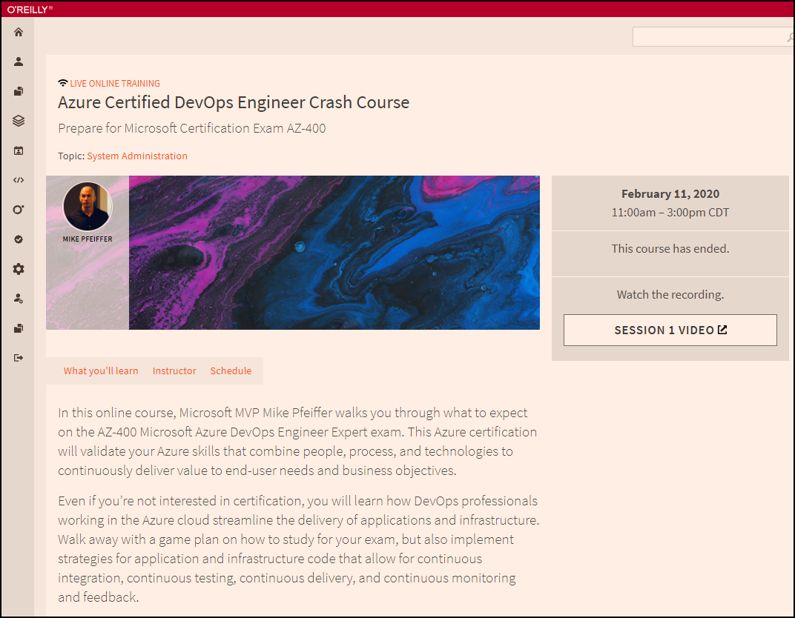
Session Recordings

Slide 9

Session Recordings

Slide 10
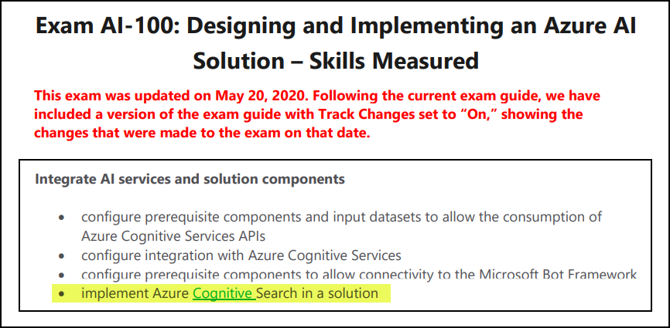
Exam AI-100 Changes (May 20, 2020!)

Slide 11
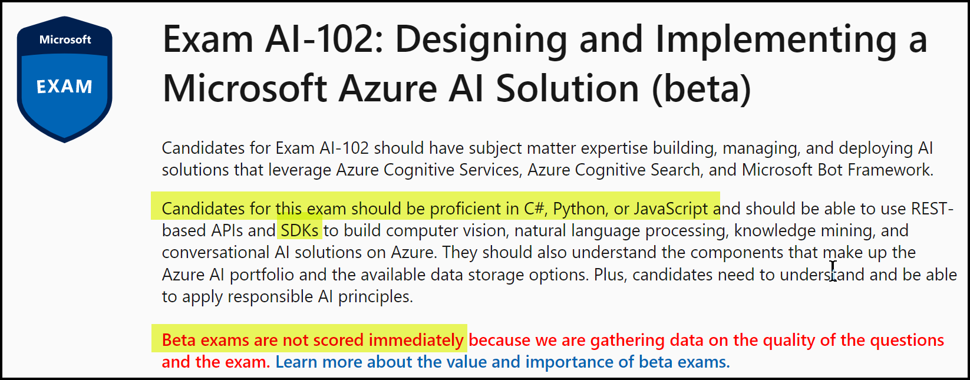
AI-102 Exam (live on July 1, 2021)

Slide 12
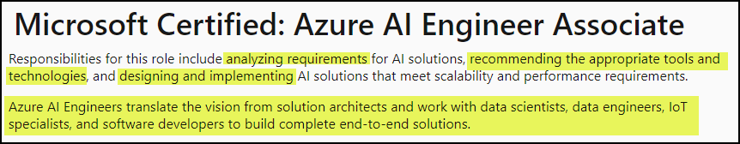
The Microsoft AI Engineer
https://timw.info/dc2ac

Slide 13
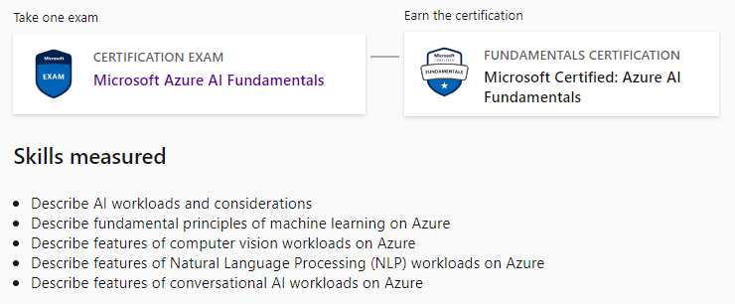
Azure AI Fundamentals
AI-900

Slide 14
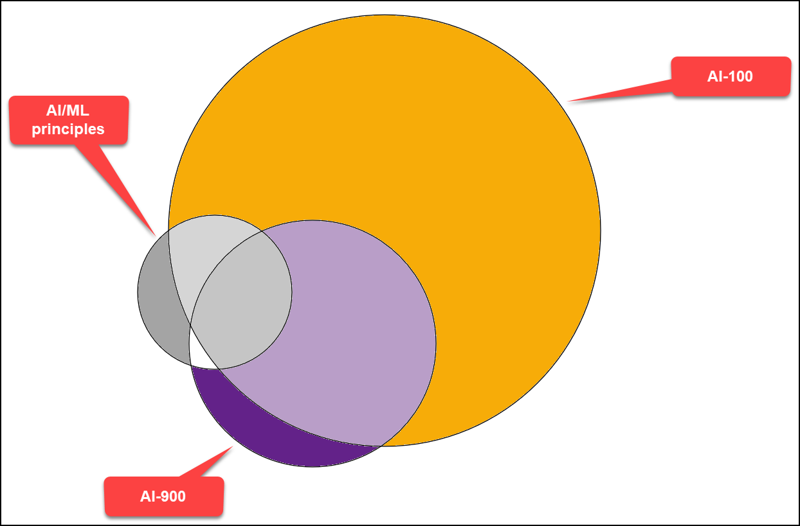
Azure AI Certification Overlap

Slide 15
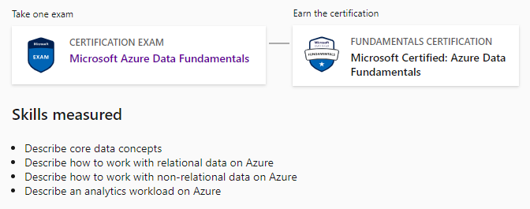
Azure Data Fundamentals
DP-900

Slide 16
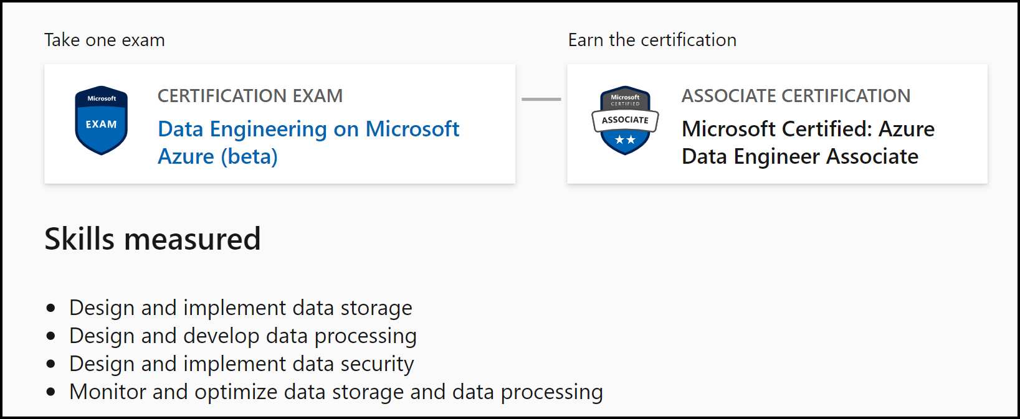
Azure Data Engineer Associate
DP-200, DP-201
DP-203
DP-100

Slide 17
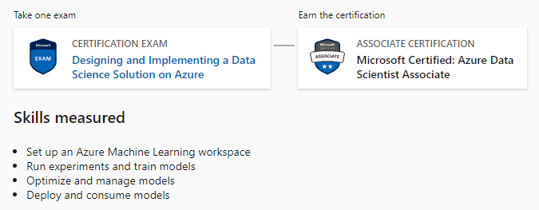
Azure Data Scientist Associate
DP-100

Slide 18
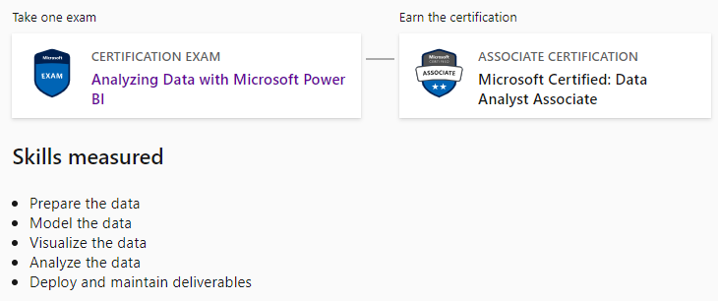
Azure Data Analyst Associate
DA-100

Slide 19

Tim's Certification Study Model
Content knowledge
Test-taking skills
Practical application

Slide 20
Thank you!
Course materials: timw.info/ai100
Twitter: @TechTrainerTim
Work: timw.info/ps
Web: TechTrainerTim.com

Slide 21
Fundamental Terminology

Slide 22
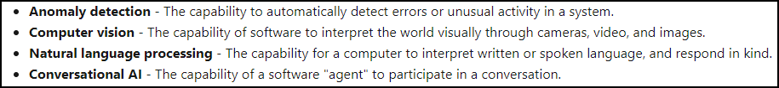
Artificial Intelligence (AI)
Any technique that enables computers to mimic human intelligence
https://timw.info/2bdb4

Slide 23
Machine Learning (ML)
Subset of AI that includes techniques that enable machines to improve at tasks with experience.
Supervised
Regression (prediction): Numeric data
Classification: Non-numeric data
Unsupervised
Clustering

Slide 24
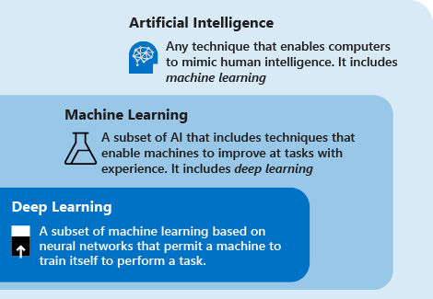
AI Schema
https://timw.info/c7769

Slide 25
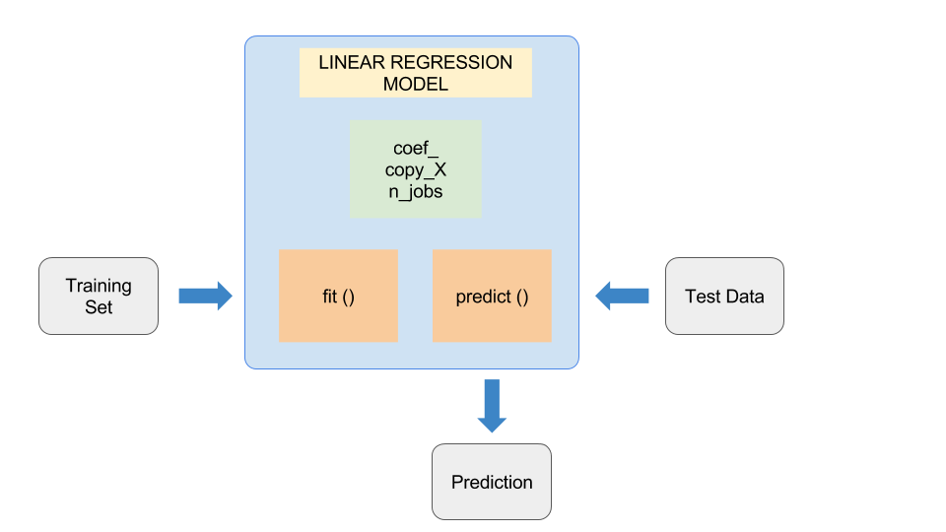
ML Model
https://timw.info/37a04

Slide 26
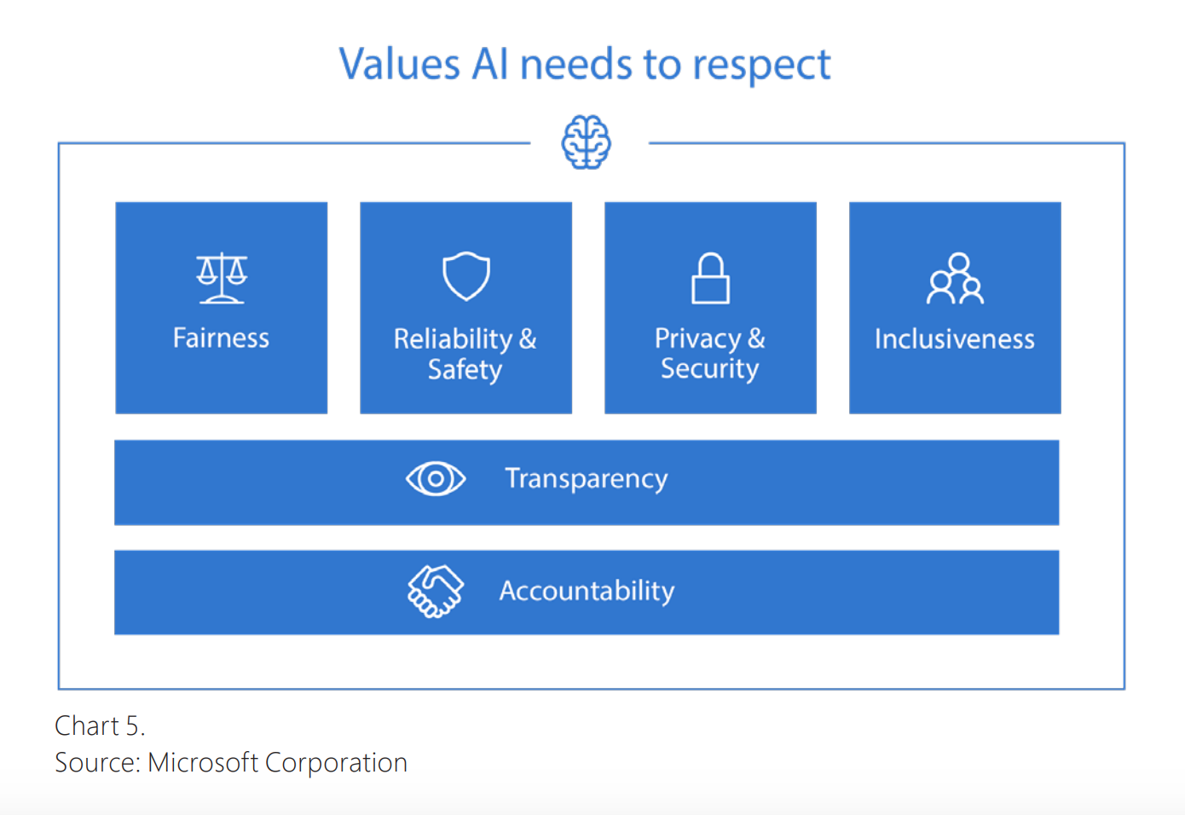

Responsible AI
Compliance Manager
https://timw.info/84db2

Slide 27
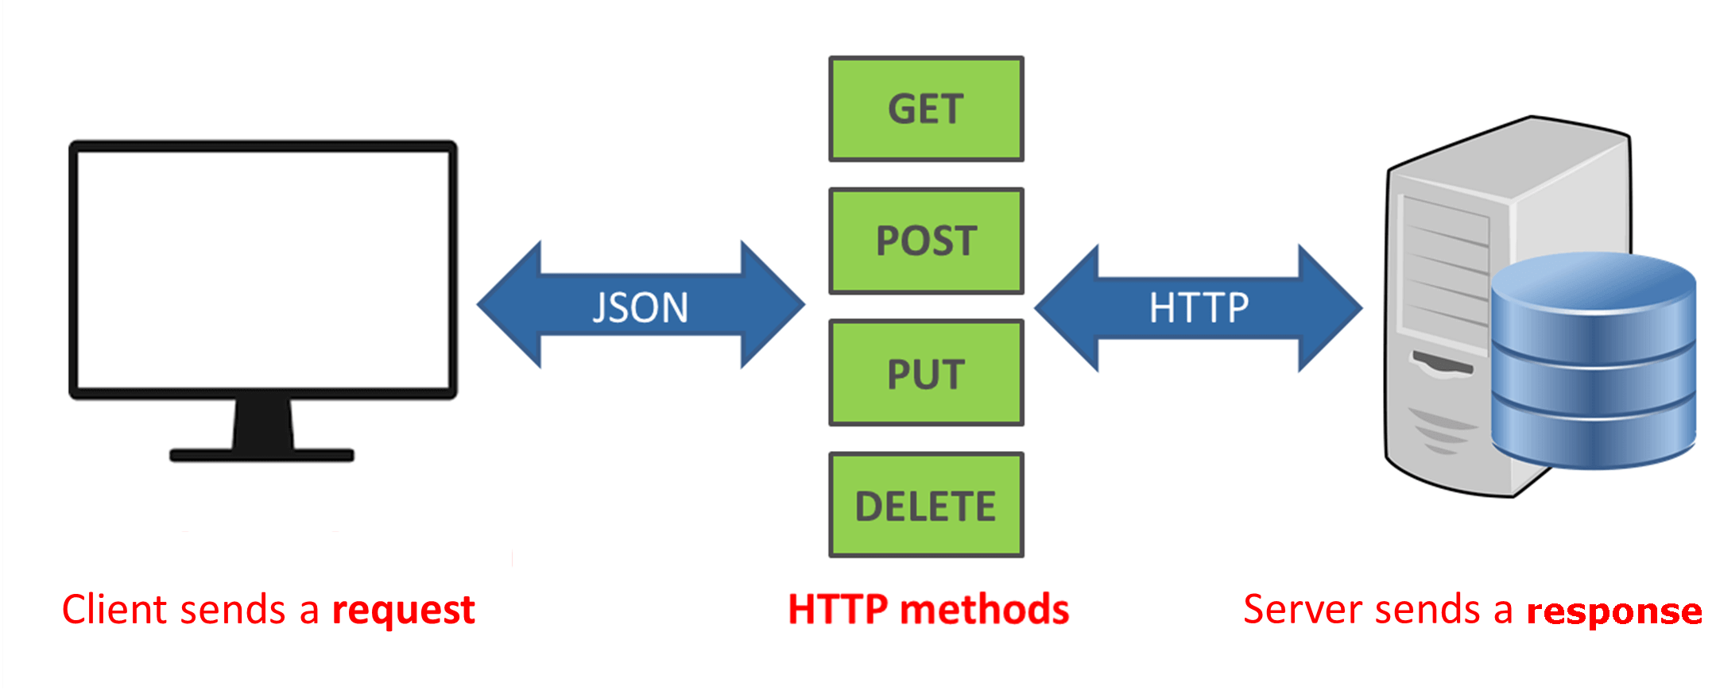
How a REST API Works
CRUD
https://timw.info/a850d

Slide 28

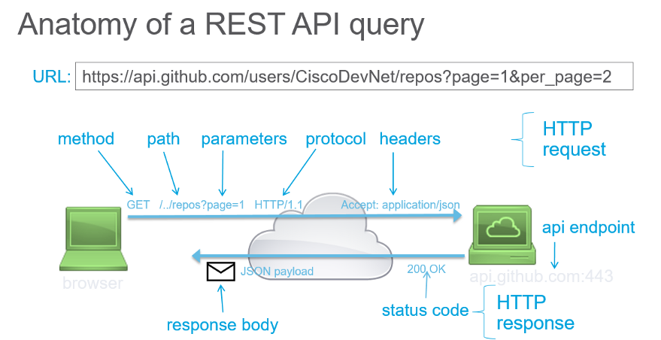
How a REST API Works
https://timw.info/d7a91

Slide 29
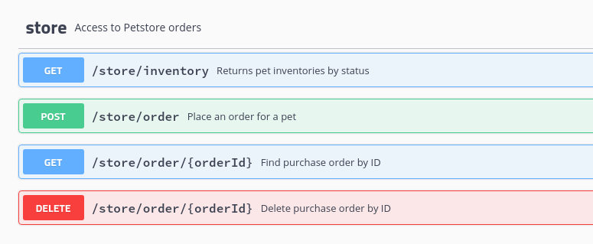
HTTP Methods
https://timw.info/cc6b1

Slide 30
Azure AI Technology Stack Overview

Slide 31
Azure AI Stack
Apache Spark on Azure (MMLSpark)
HDInsight
Databricks
Azure Machine Learning
Azure Cognitive Services
Azure Cognitive Search
Azure Bot Service

Slide 32
Azure Cognitive Services
Vision
Computer Vision
Face
Video Indexer
Speech
Speech to Text
Speaker Recognition
Speech Translation

Slide 33
Azure Cognitive Services
Language
Text Analytics
LUIS
Decision
Content Moderator
Search
Bing Search
Bing Statistics

Slide 34
Azure AI Related Services

Slide 35
Azure SQL Database Family
SQL Server in a Virtual Machine
SQL Server Machine Learning Services
Azure Synapse Analytics
Azure SQL Data Warehouse (OLAP)
SQL & Spark pools
Azure SQL Database
OLTP
Azure SQL Database Managed Instance
SQL Server ML Services
https://timw.info/7e4a3

Slide 36
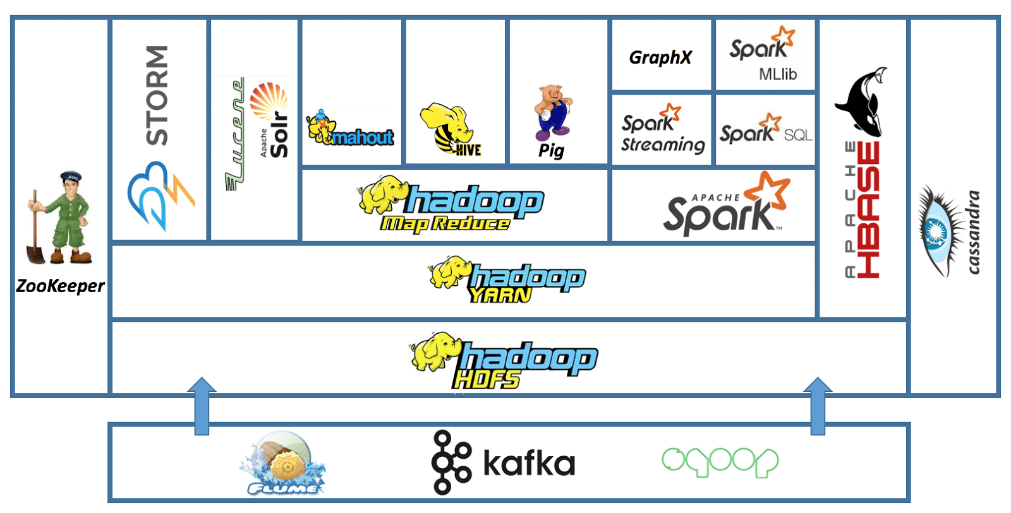
Apache Hadoop
Event Hub
HDInsight
Service Bus
https://timw.info/7f992

Slide 37
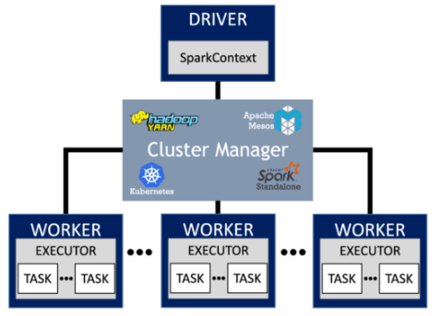
Apache Spark
https://timw.info/7e4a3

Slide 38
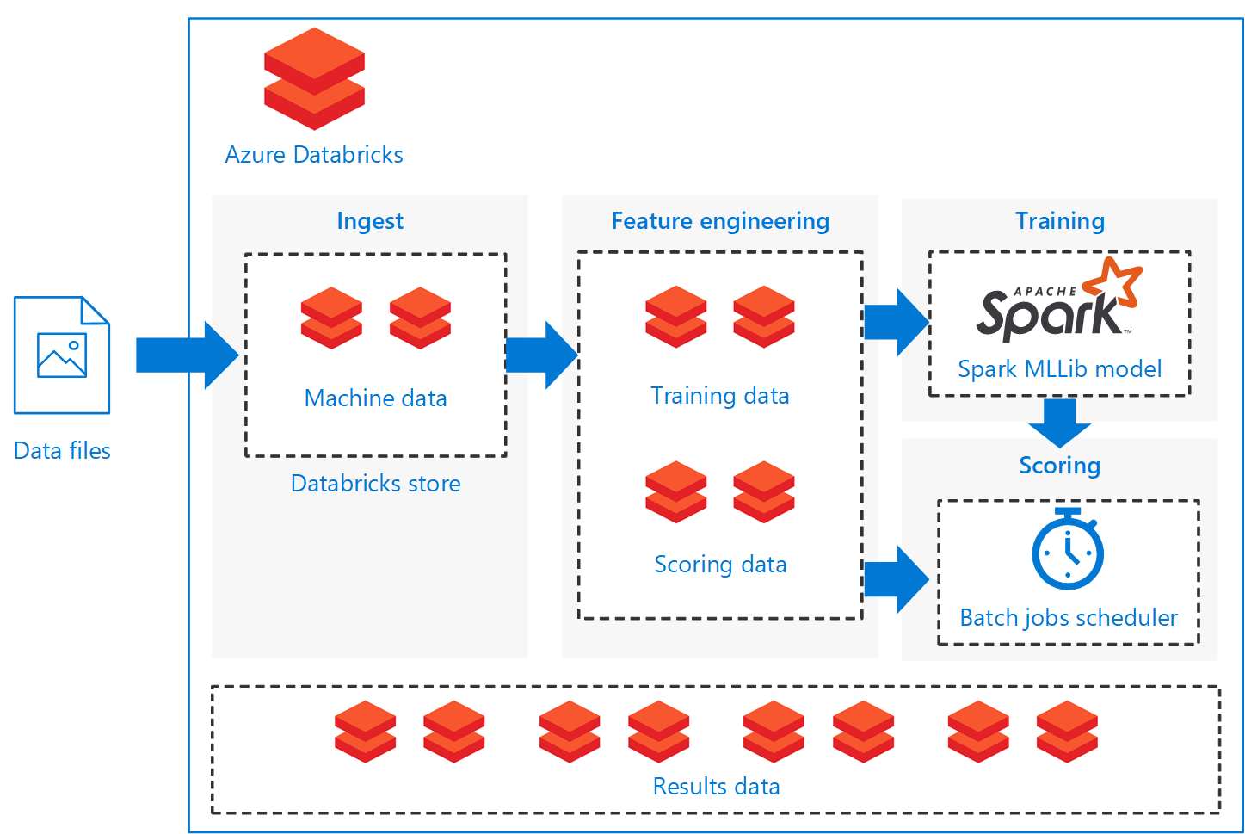
Databricks
https://timw.info/a9ab9

Slide 39
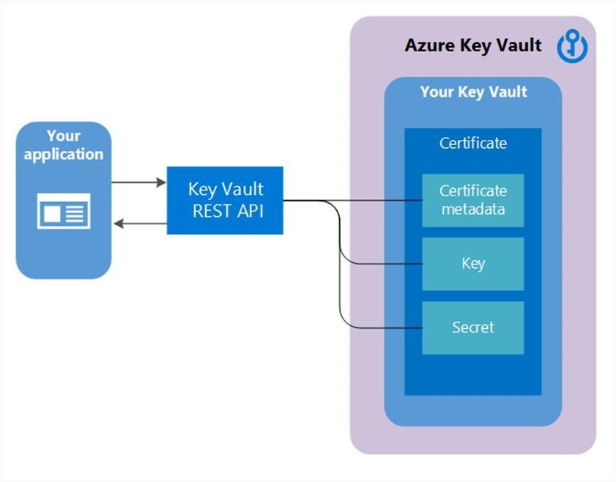
Azure Key Vault
Soft delete
Purge protection
https://timw.info/22bfc

Slide 40
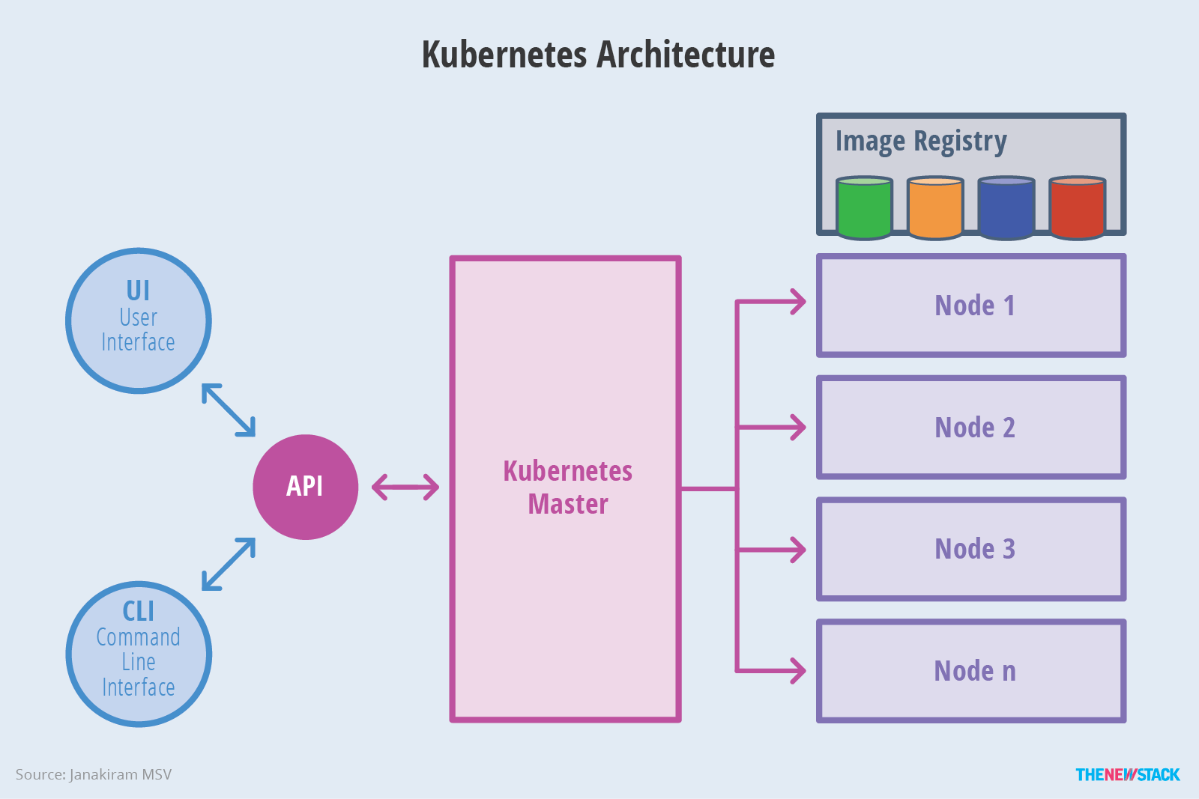

Azure Kubernetes Service (AKS)
SSH
Azure CLI
kubectl
https://timw.info/f888f

Slide 41
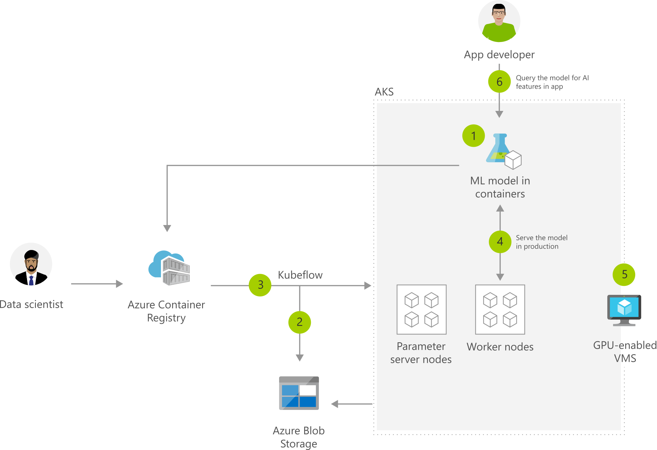
Machine Learning with AKS
https://timw.info/2b505

Slide 42
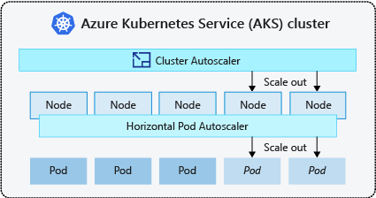
AKS Scaling
https://timw.info/1c670

Slide 43
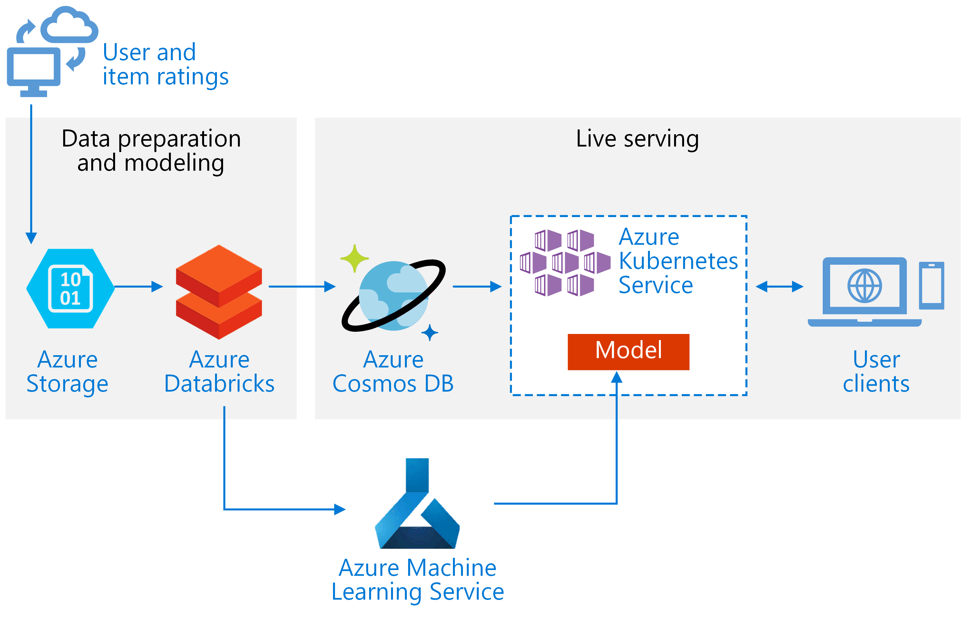
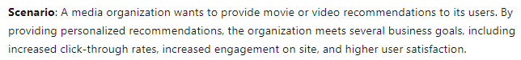
Real-Time Recommendation API
https://timw.info/e25e0

Slide 44
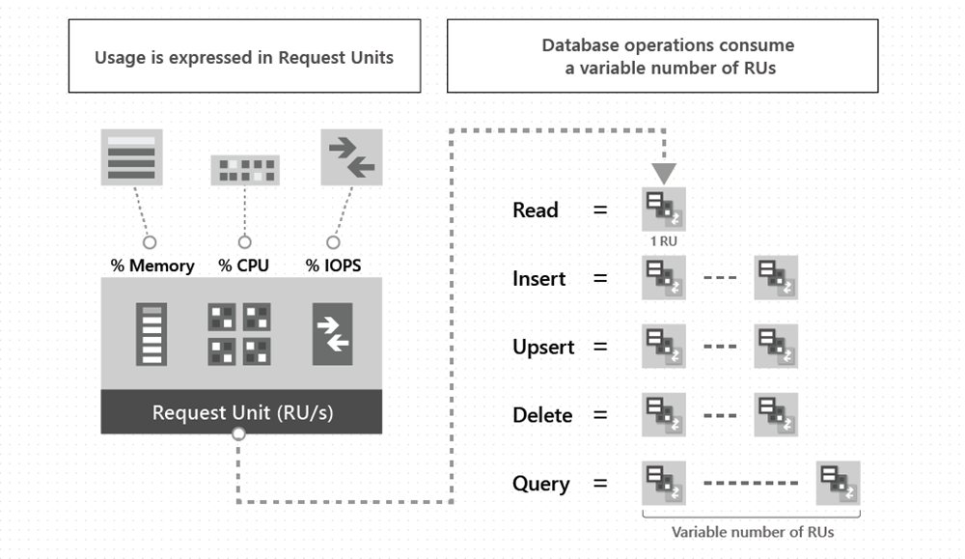
Cosmos DB Request Units
https://timw.info/65a44

Slide 45
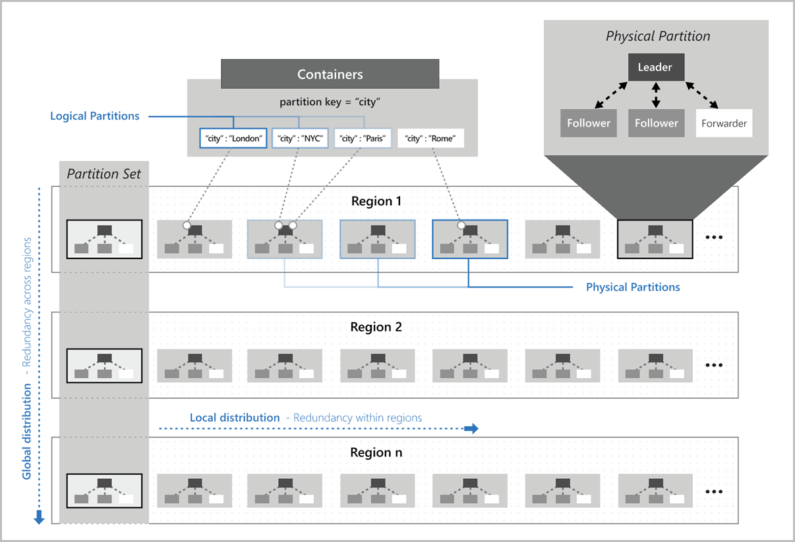
Cosmos DB Partitioning
https://timw.info/2c1f8

Slide 46

Azure Data Factory
ETL & ELT
https://timw.info/1ebb5

Slide 47
Use Cases

Slide 48
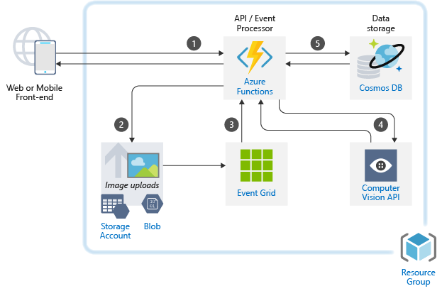
Use Case: Image Classification
https://timw.info/caa25

Slide 49
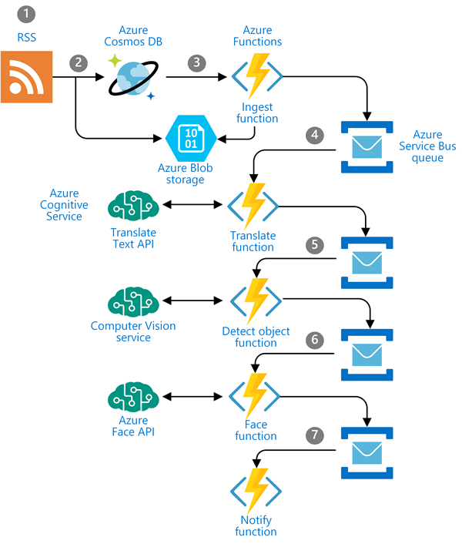
Use Case: Newsfeed Ingestion
https://timw.info/c0015

Slide 50
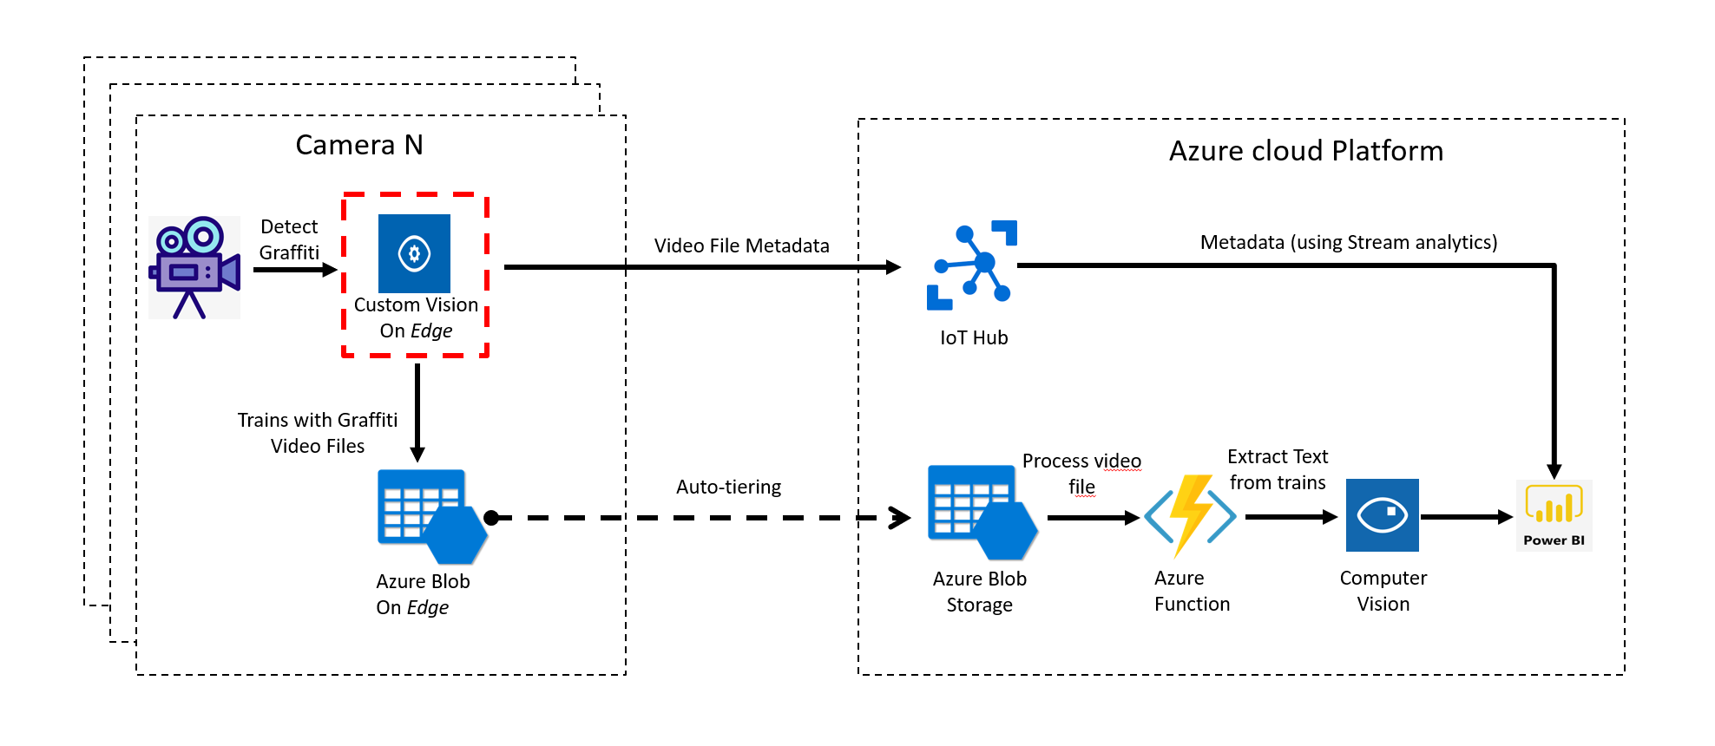
Use Case: IoT
https://timw.info/3f2c0

Slide 51
Azure Machine Learning

Slide 52
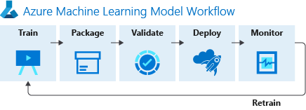
ML Workflow
https://timw.info/f82d3

Slide 53
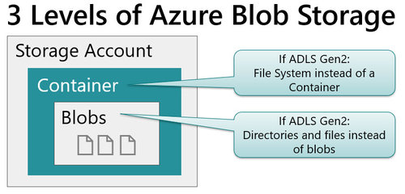
Blob Storage and Data Lake Storage
CSV, JSON
https://timw.info/772f8

Slide 54
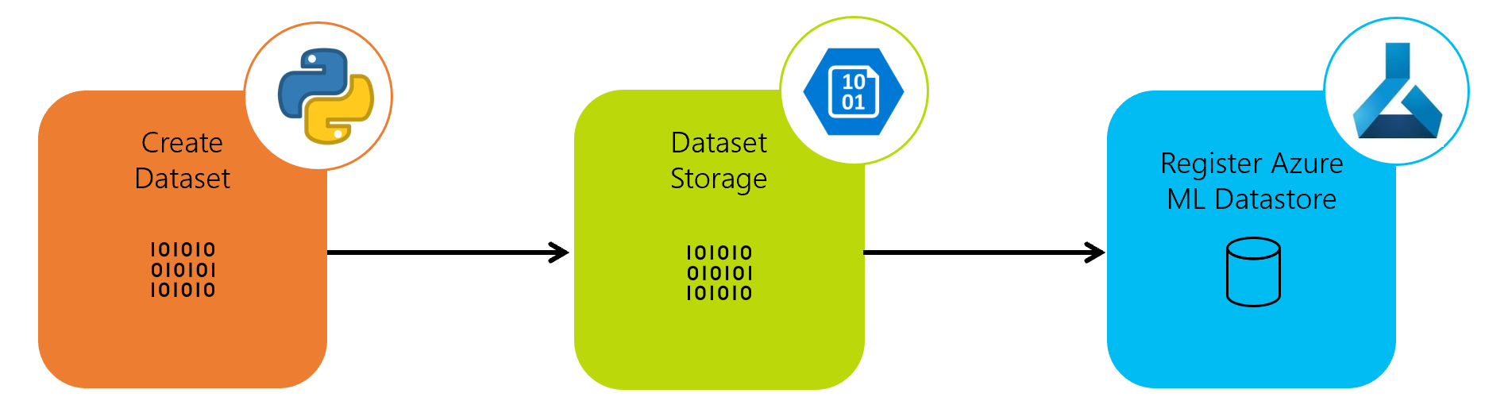
Azure ML Dataset & Datastore
https://timw.info/a1df2

Slide 55
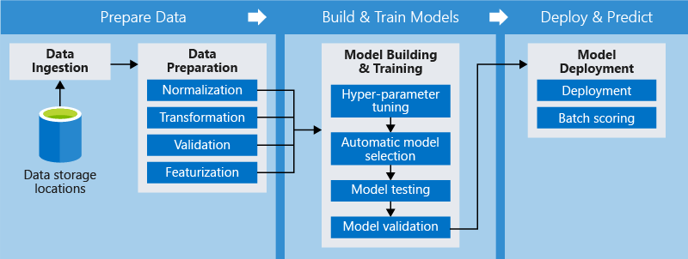
Azure ML Pipeline
https://timw.info/d572e

Slide 56
Azure Cognitive Services

Slide 57
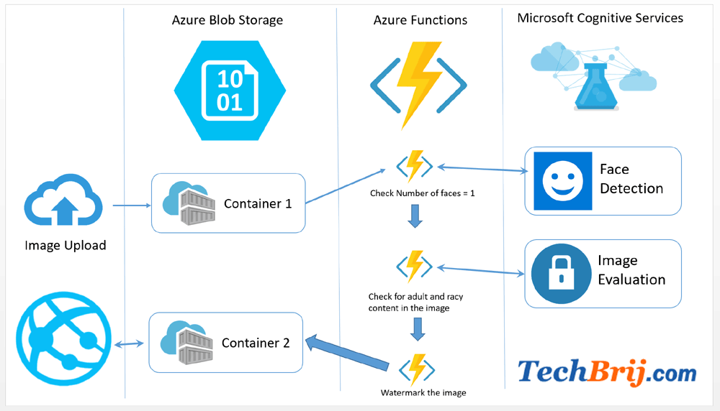

First Things First
Cognitive Services multi-service account
Azure Functions
https://timw.info/89e3b

Slide 58
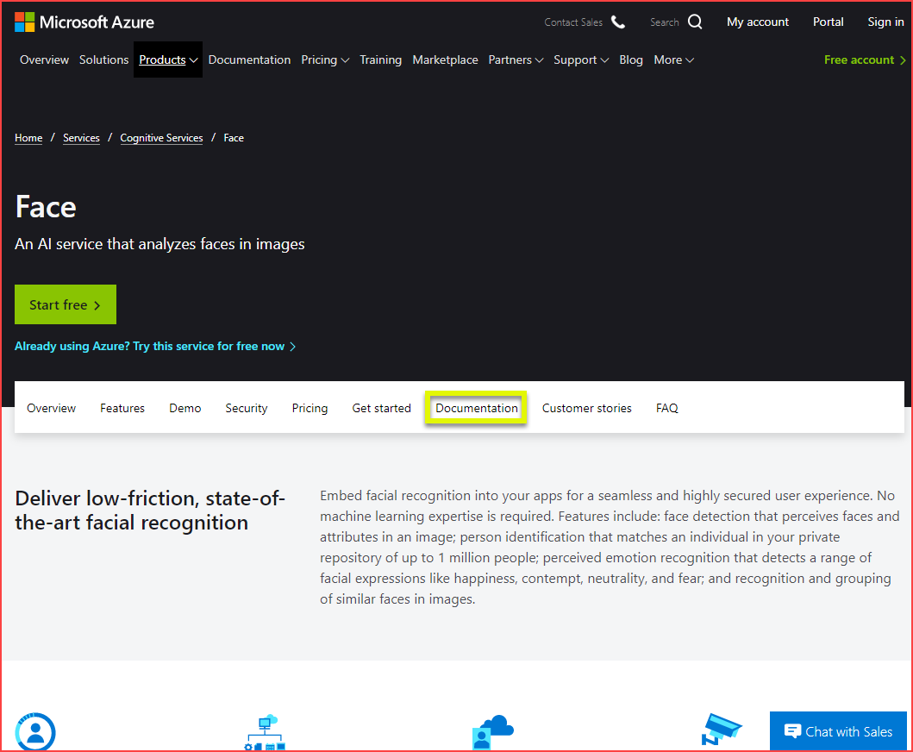
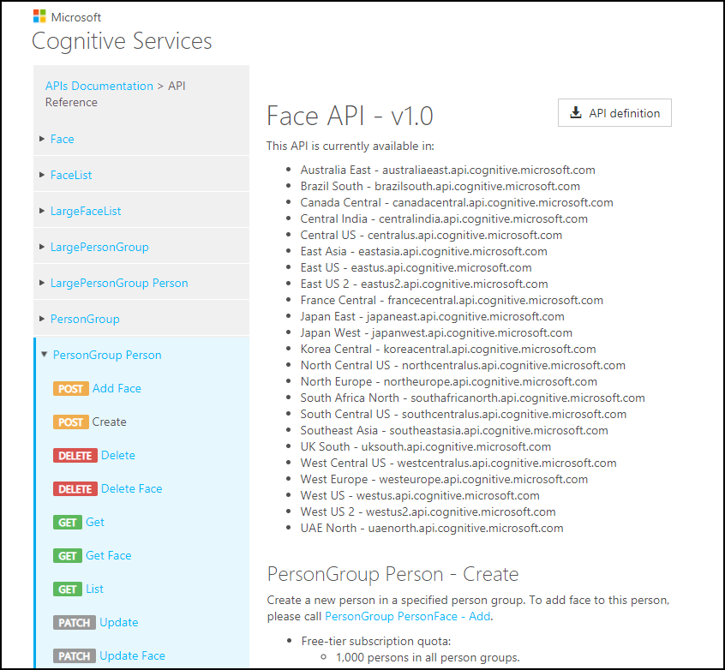
How To Know Cognitive Services

Slide 59
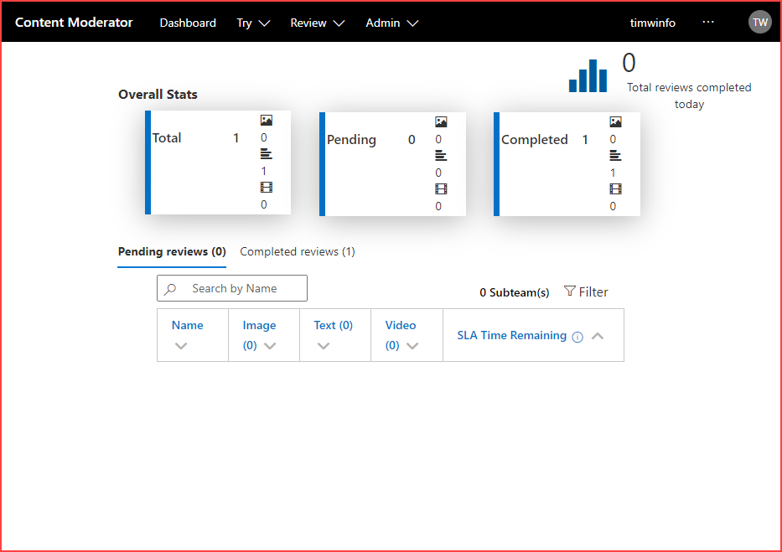
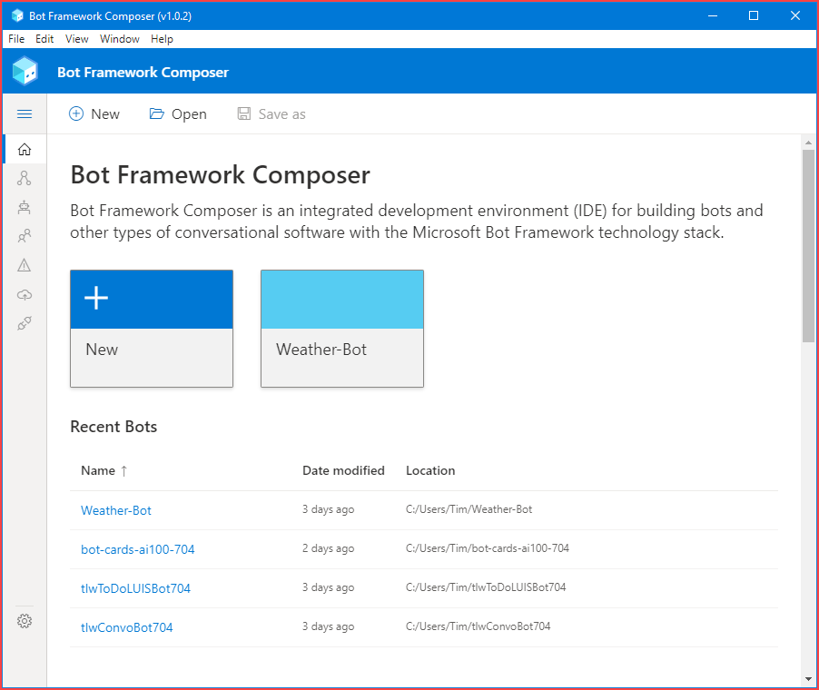
How To Know Cognitive Services

Slide 60
Computer Vision
Digital Asset Management (DAM) solution for image data
Detect objects and features
Detect corporate brands/logos
Describe an image
Optical character recognition (OCR)
Generate thumbnail
https://timw.info/bb965

Slide 61
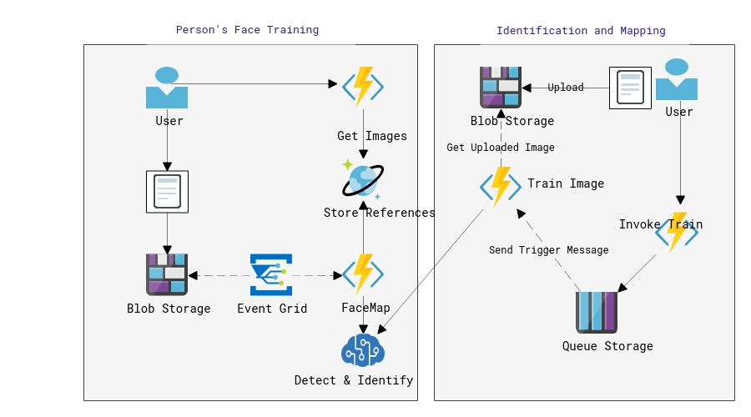
Face
Facial recognition
Facial verification
Emotion recognition
Person Group containers:
Person Group (10,000 persons)
Large Person Group (1M persons)
https://timw.info/31118

Slide 62
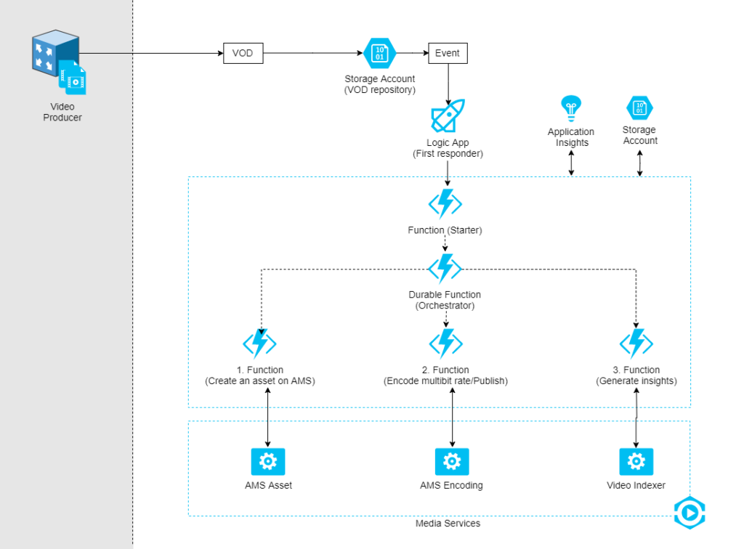
Video Indexer
Extract meaning from video and audio files
Index faces and spoken words
Great for making content available to vision- or hearing-challenged users
Content moderation
Azure Media Services
Encoding
https://timw.info/d0b4b

Slide 63
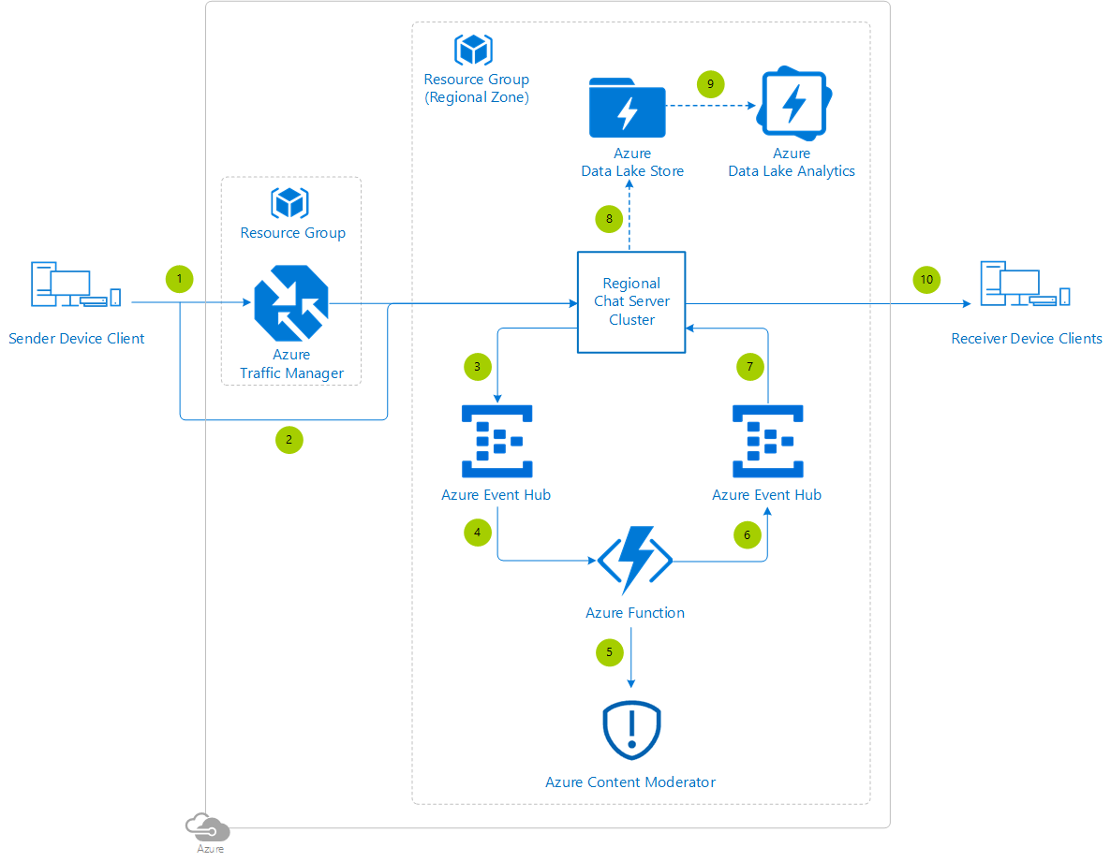
Content Moderator
Checks text, image, and video content for potentially undesirable content
Profanity
Adult or "racy" content
https://timw.info/7eec2

Slide 64
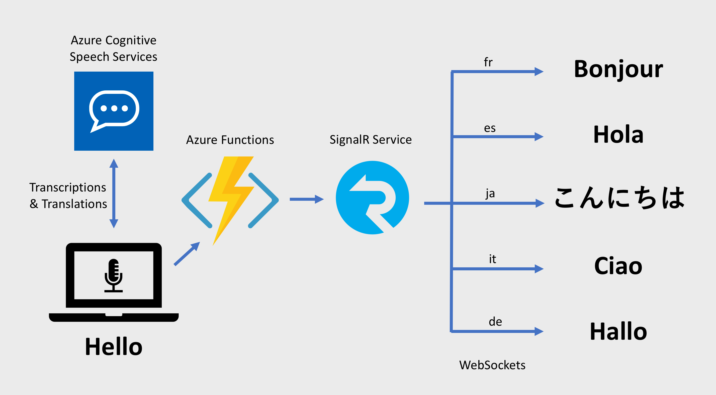
Speech
Speech-to-text: Transcribe audio from >40 languages
Speaker recognition:
Voice signature
https://timw.info/18876

Slide 65
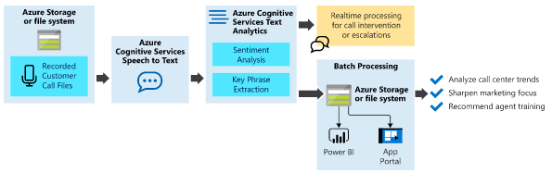
Text Analytics
Language detection
Sentiment analysis
Entity extraction
People
Places
Organizations
Objects
Translator: 60 languages
https://timw.info/87290

Slide 66
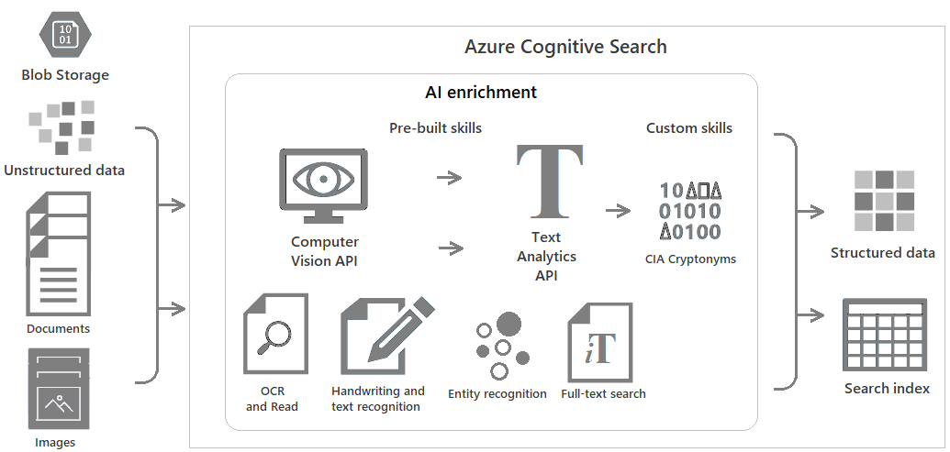
Azure Cognitive Search
https://timw.info/c6ab1

Slide 67
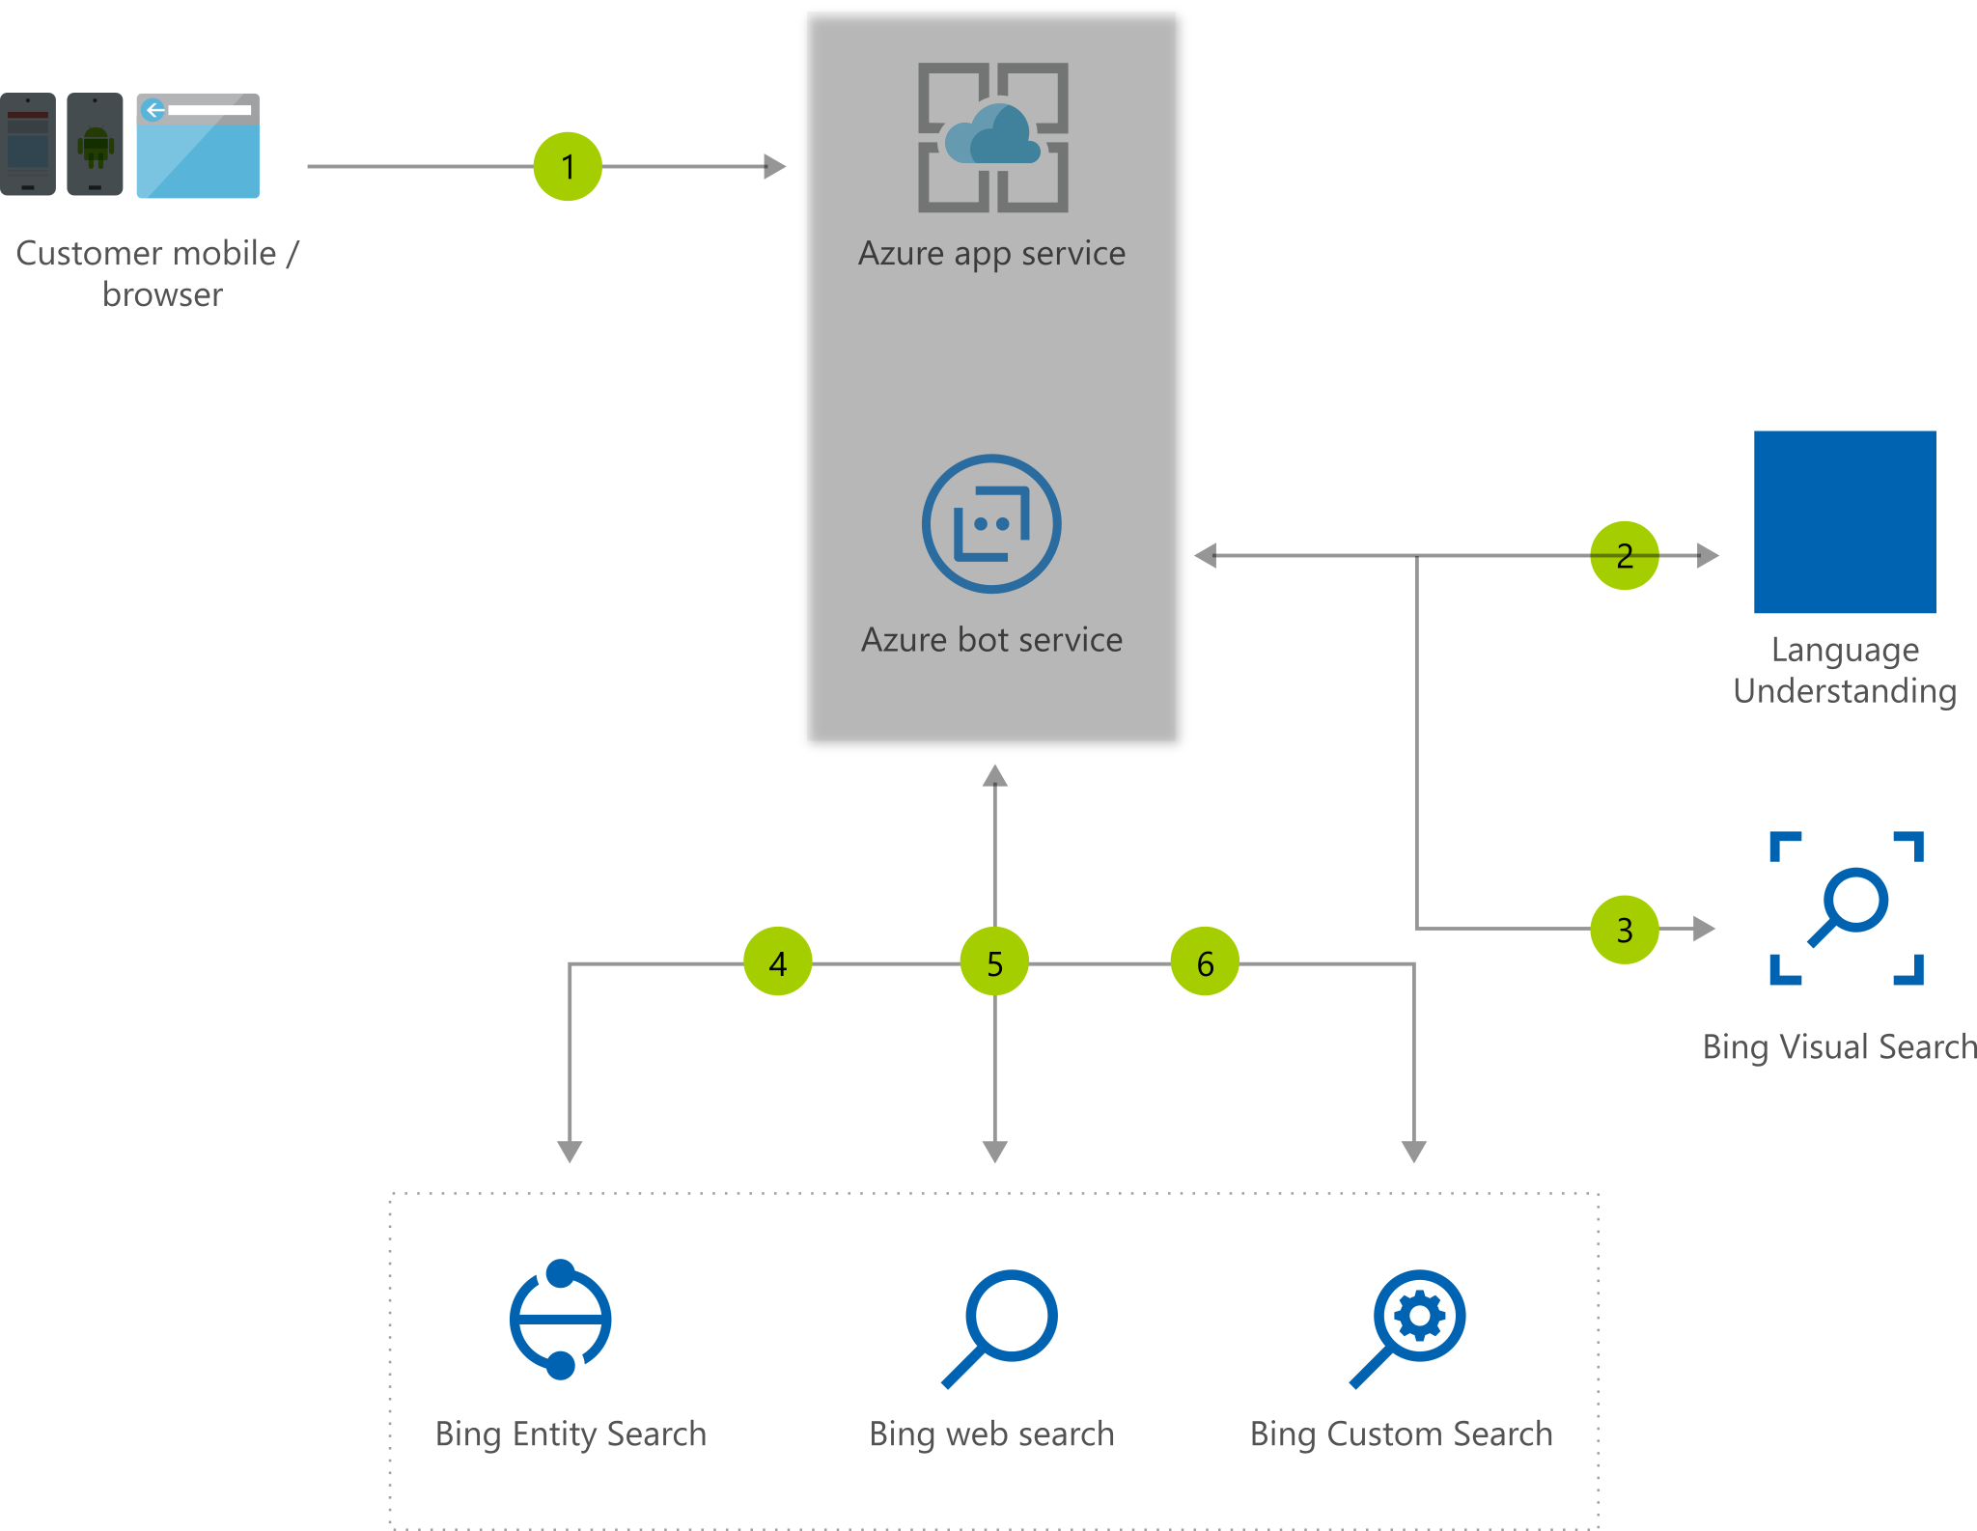
Bing Web Search
Retrieve answers from Bing search engine
Web pages
Images
Videos
News
https://timw.info/7640a

Slide 68
Azure Bot Service

Slide 69
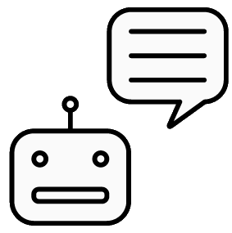
What is a Bot?
Chatbot
Computer programmed designed to mimic human interaction
Turn based text/audio conversation
Alternative UI
Language Understanding Intelligent Service (LUIS)
Cortana

Slide 70
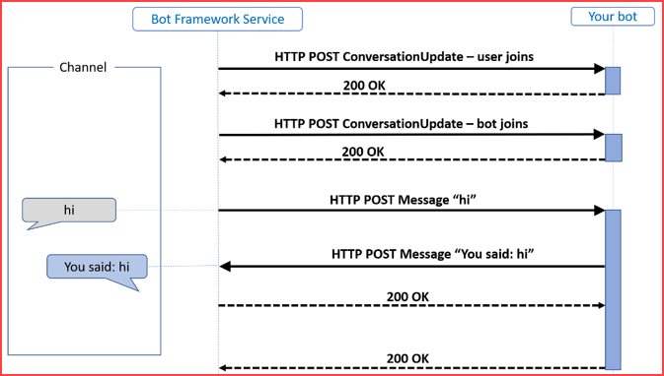
Azure Bot Service
Toolset to develop "intelligent agents"
Graphical:
Bot Framework Composer
Code:
Bot Framework SDK
C#, Python, JavaScript, Java
https://timw.info/87290

Slide 71
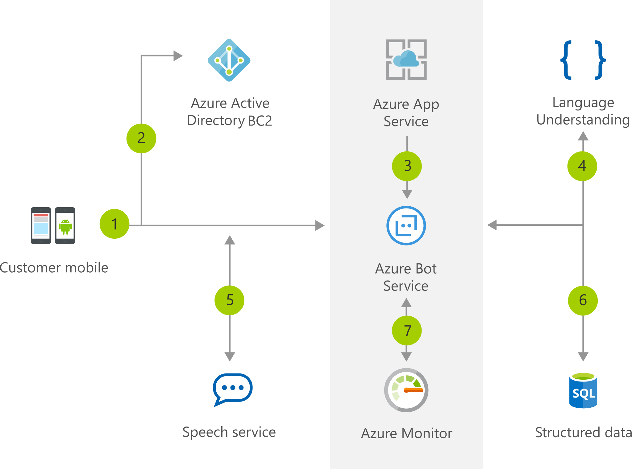
Chatbot
https://timw.info/b04eb

Slide 72

Conversational Bot
https://timw.info/32e9e

Slide 73
Monitoring

Slide 74

Azure Monitoring
https://timw.info/azmon

Slide 75
Exam AI-100 Strategy

Slide 76
Tim's Certification Study Pyramid
Interdependence
Content knowledge
Practical application
Test-taking skills

Slide 77
Item Types

Slide 78

Single Answer Multiple Choice

Slide 79

Multiple Answer Multiple Choice

Slide 80
Repeated Scenario
You need to move an Azure VM to another hardware host.
Solution: You redeploy the VM.
Does this solution meet the goal?
Yes
No

Slide 81
Repeated Scenario
You need to move an Azure VM to another hardware host.
Solution: You enable boot diagnostics.
Does this solution meet the goal?
Yes
No

Slide 82

Select and Place

Slide 83

Build List and Reorder

Slide 84

Active Screen/Fill in the Blank

Slide 85

Case Study

Slide 86






Performance-Based Lab

Slide 87
Microsoft Online Testing

Slide 88
Tim's Online Testing Video (YouTube)
timw.info/online

Slide 89

Microsoft Online Testing Process

Slide 90

Microsoft Online Testing Process

Slide 91

Microsoft Online Testing Process

Slide 92

Microsoft Online Testing Process

Slide 93

Microsoft Online Testing Process

Slide 94

Microsoft Online Testing Process

Slide 95

Microsoft Online Testing Process

